Slide 1
CASE STUDY 21.3
TAYKO SOFTWARE CATALOGER

Slide 2
Content
Business Need
Objective
Data Exploration
Correlation and PCA
Logistic Regression
Evaluation
Linear Regression
Feature selection using backward elimination, forward selection and stepwise selection
Conclusion

Slide 3
BUSINESS NEED
Come up with predictive model to select customers with high probability of purchase

Slide 4
Objective
The objectives of this project are two-folds
i- Build a classifier model, to identify purchaser and non-purchaser
ii- Build a regression model , to predict spending by purchasers

Slide 5
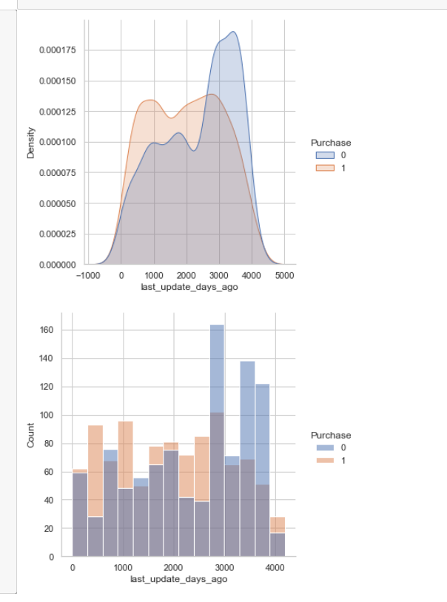
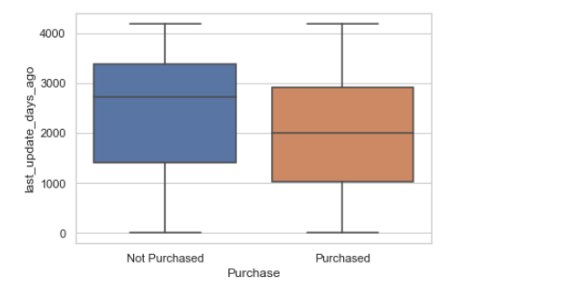
Data Exploration
Purchase vs Non-Purchase against days since last update of customer record.
For Non-Purchasers , distribution look more negatively skewed. Most of records weren’t updated since last 3000 days or more

Slide 6
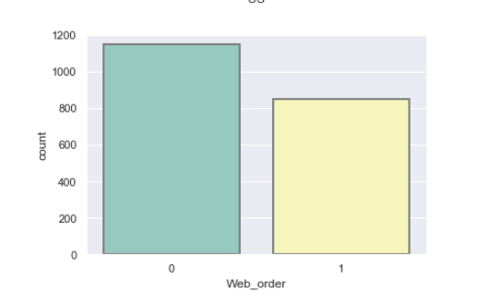
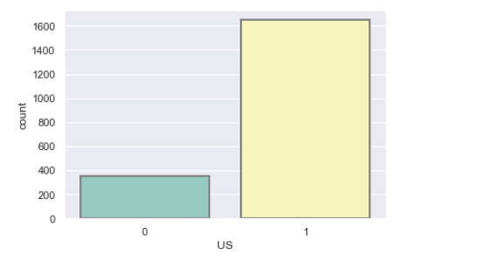
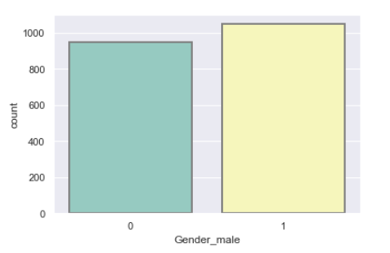
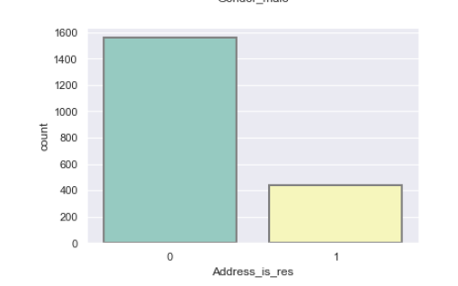
Data Exploration
Binomial variables counts:
1- There are more records from US, then any other.
2- Most records are not web orders
3- There not huge difference for customer being Male or Female
4- Most records have non residential address

Slide 7
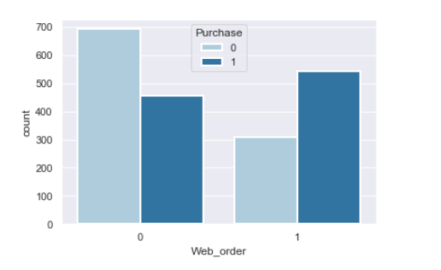
Data Exploration
Those who don’t place order through web, are majority non-purchasers.
Those who places order through web, are majority purchasers.

Slide 8
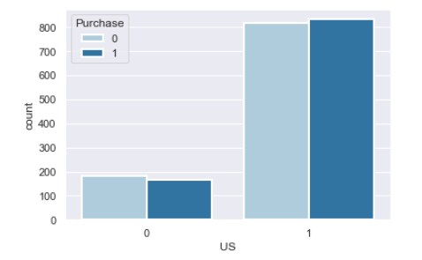
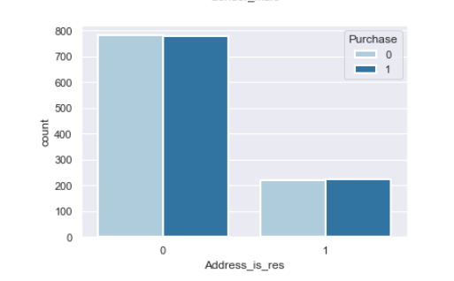
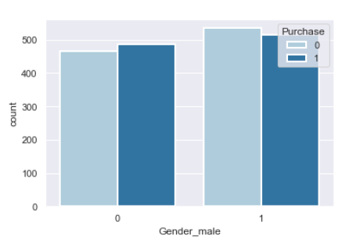
Data Exploration
No significant difference among purchasers or non-purchasers for other binomial variables

Slide 9
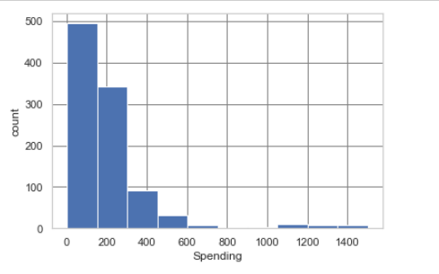
Data Exploration
Spending Distribution is positively skewed, most purchasers spends < 200$
A small fraction of customers spends $1100 or more

Slide 10
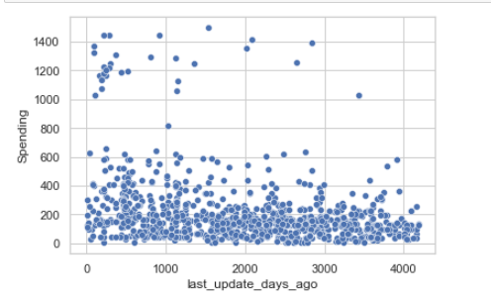
Data Exploration
Spending vs last update days ago
This shows records which were updated recently have higher spending customers

Slide 11
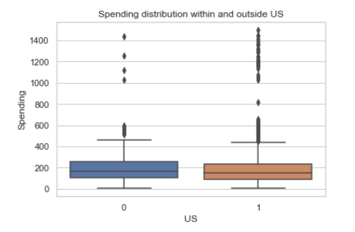
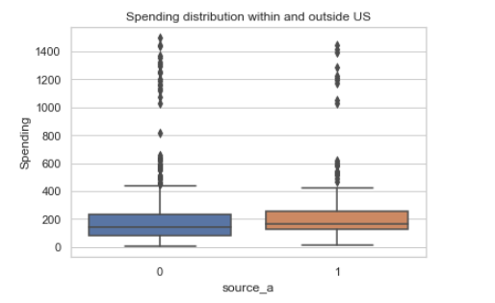
Data Exploration
Spending in US have more outliers, showing some spends high amount in US
Customers who doesn’t spend on “source-a” catalog spends higher

Slide 12
Correlation and PCA
Next step, we check correlation among features and perform PCA
First principal component captures days since last update was made_, and _days since first update was made. These both are 81% correlated and 1st PC is dominated by these.
2nd PC captures source_w
3rd PC captures Gender_,and whether the customer place an order( _Web order )
4th PC captures Web order and source_u
PC 5 and 6 captures whether a customer is from US, while PC 6 also captures source_a
About 8 PCs captures around 89% of variation, so this might be a good choice.

Slide 13
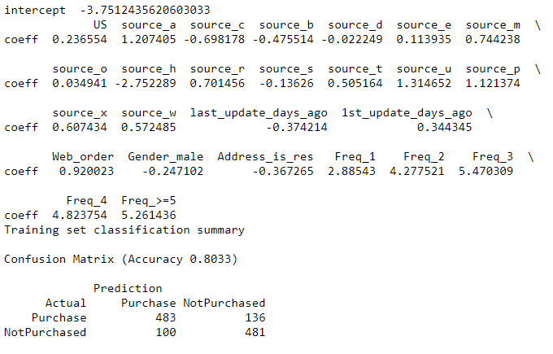
LOGISTIC REGRESSION
Steps:
First we dummify categorical variables
Normalized continuous variables( 1st and last day update )
Target column= Purchase
Partition = 60% training set, 40% validation set

Slide 14
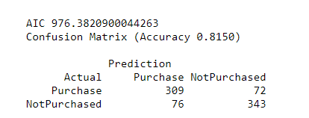
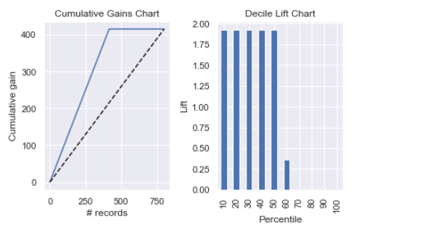
Evaluation
Steps:
We checked validation accuracy and confusion matrix
Lift and gain analysis
Decile lift chart shows, if we pick top 10% (upto 50%) of customers, we would have 1.8 times higher probability of getting a purchase, than picking 10% randomly.

Slide 15
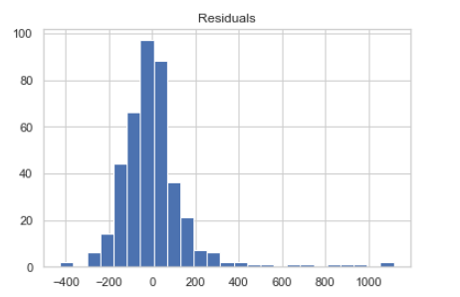
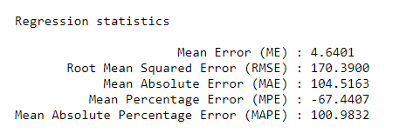
LINEAR REGRESSION
Steps:
First we dummify categorical variables
Normalized continuous variables( 1st and last day update )
Target column= Spending
Using all variables as predictor
Partition: 60% training, 40% validation
Validation Residual distribution

Slide 16
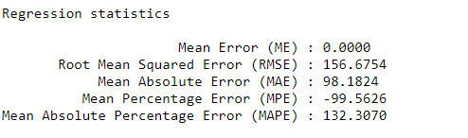
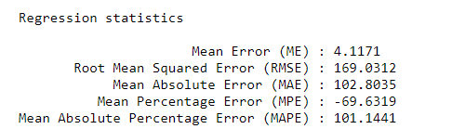
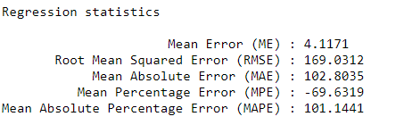
Backward elimination, Forward selection, stepwise selection
All three resulted in same set of variables
Best Variables: Freq, Address_is_res, 1st_update_days_ago,
source_r, source_a, source_u, source_h
Training set Regression statistics
Validation set Regression statistics with best variables

Slide 17
Conclusion
We built a framework to
1- Classify customer in purchaser vs non-purchasers,
2- Predict the spending amount by each customer
Our results support the model performance, however we can improve
these more by using different set of algorithm.

